Slide 1
Additional Trigonometric Topics
Precalculus
Chapter 6

Slide 2
This Slideshow was developed to accompany the textbook
Precalculus
By Richard Wright
https://www.andrews.edu/~rwright/Precalculus-RLW/Text/TOC.html
Some examples and diagrams are taken from the textbook.
Slides created by
Richard Wright, Andrews Academy
rwright@andrews.edu

Slide 3
6-01 Law of Sines
In this section, you will:
Solve oblique triangles using the law of sines.
Find the area of a triangle using two sides and the included angle.

Slide 4
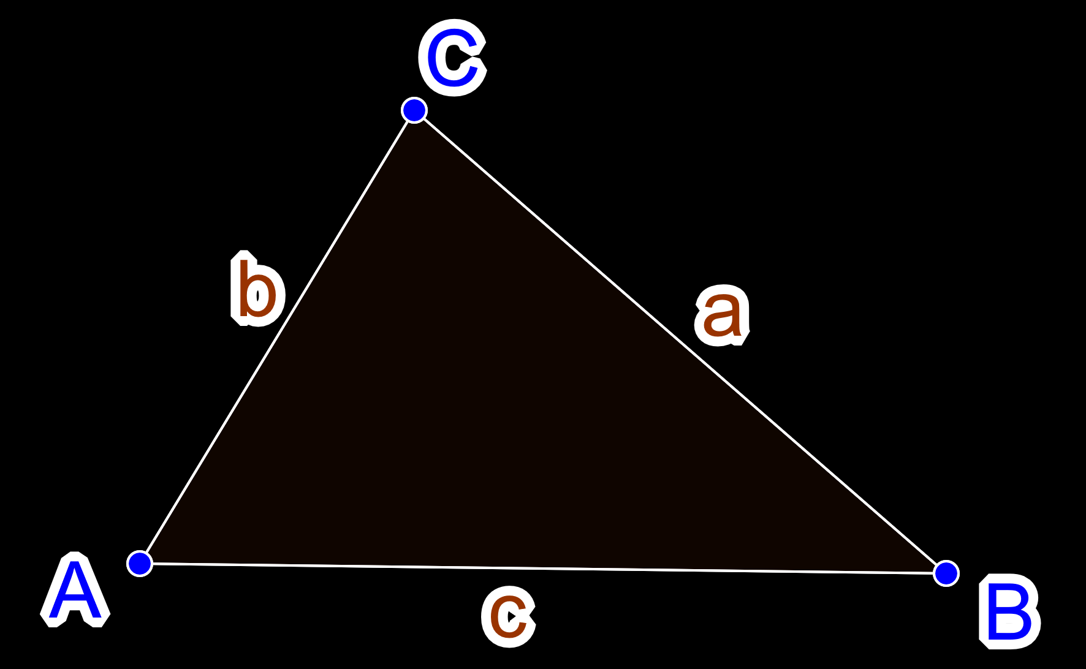
6-01 Law of Sines
Solve a triangle
Find all side lengths and angle measures
Use Law of Sines if you know
2 angles and 1 side (ASA or AAS)
2 sides and 1 opposite angle (SSA)
Law of Sines
$\frac{\sin{A}}{a}=\frac{\sin{B}}{b}=\frac{\sin{C}}{c}$

Slide 5
6-01 Law of Sines
Solve ΔABC where A = 30°, B = 45°, and a = 32 ft
Notes:
$$\frac{\sin{A}}{a}=\frac{\sin{B}}{b}$$
$$\frac{\sin{30°}}{32}=\frac{\sin{45°}}{b}$$
$$b\sin{30°}=32\sin{45°}$$
$$b \left(\frac{1}{2}\right)=32\left(\frac{\sqrt{2}}{2}\right)$$
$$b=32\sqrt{2} ft≈4525 ft$$
$$A+B+C=180°$$
$$30°+45°+C=180°$$
$$C=105°$$
$$\frac{\sin{A}}{a}=\frac{\sin{C}}{c}$$
$$\frac{\sin{30°}}{32}=\frac{\sin{105°}}{c}$$
$$c\sin{30°}=32\sin{105°}$$
$$c=61.82 ft$$

Slide 6
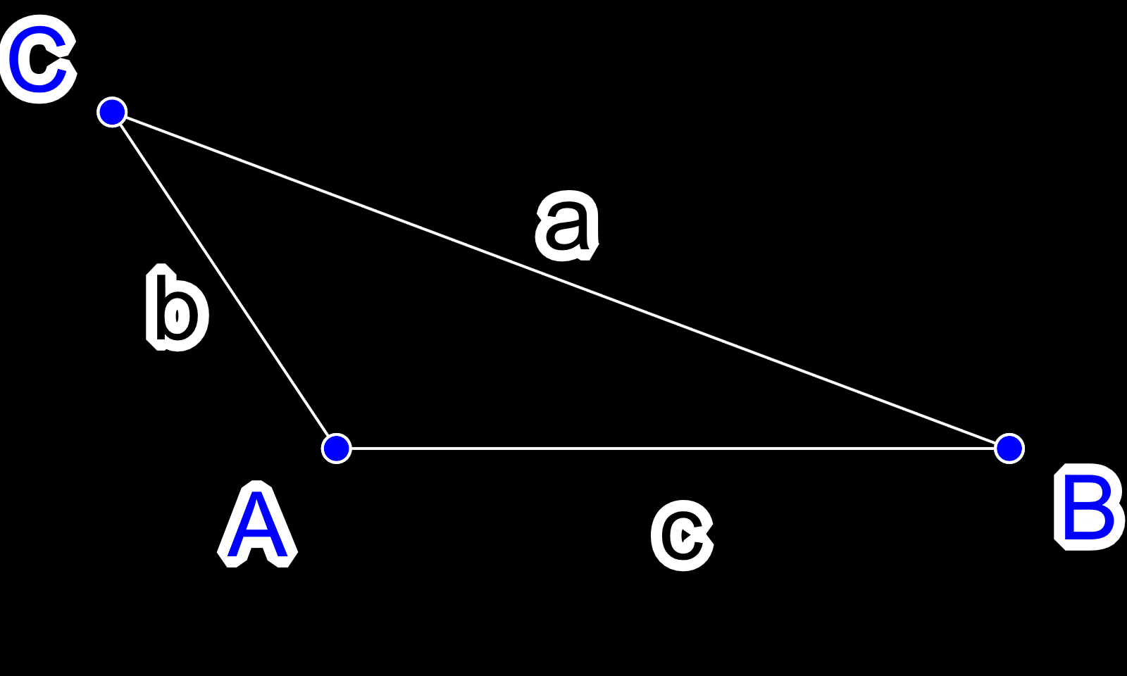
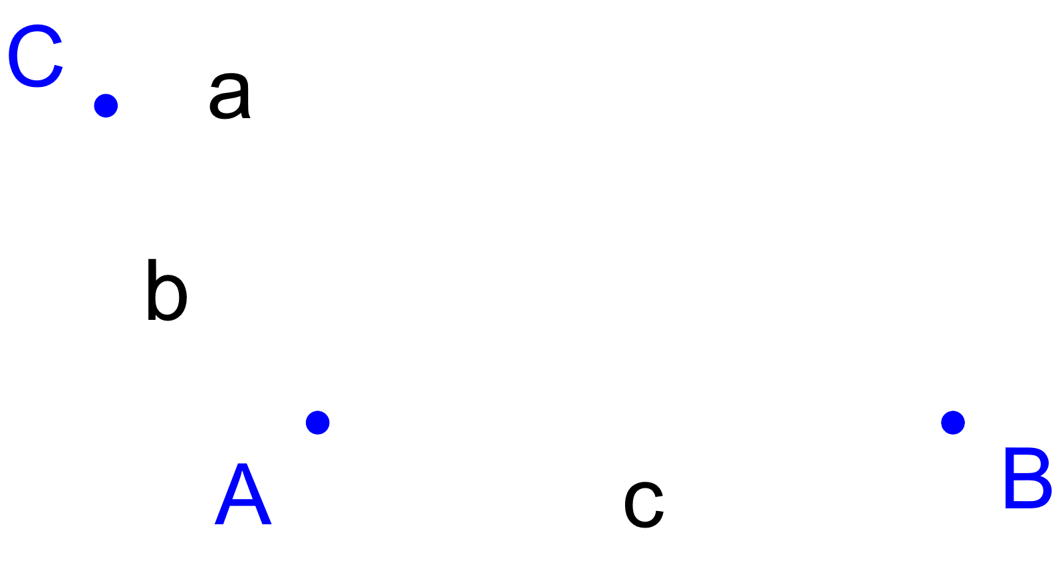
6-01 Law of Sines
The Ambiguous Case (SSA)
(Given A, a, b)
If A > 90° and
a ≤ b, then 0 solutions
a > b, then 1 solution

Slide 7
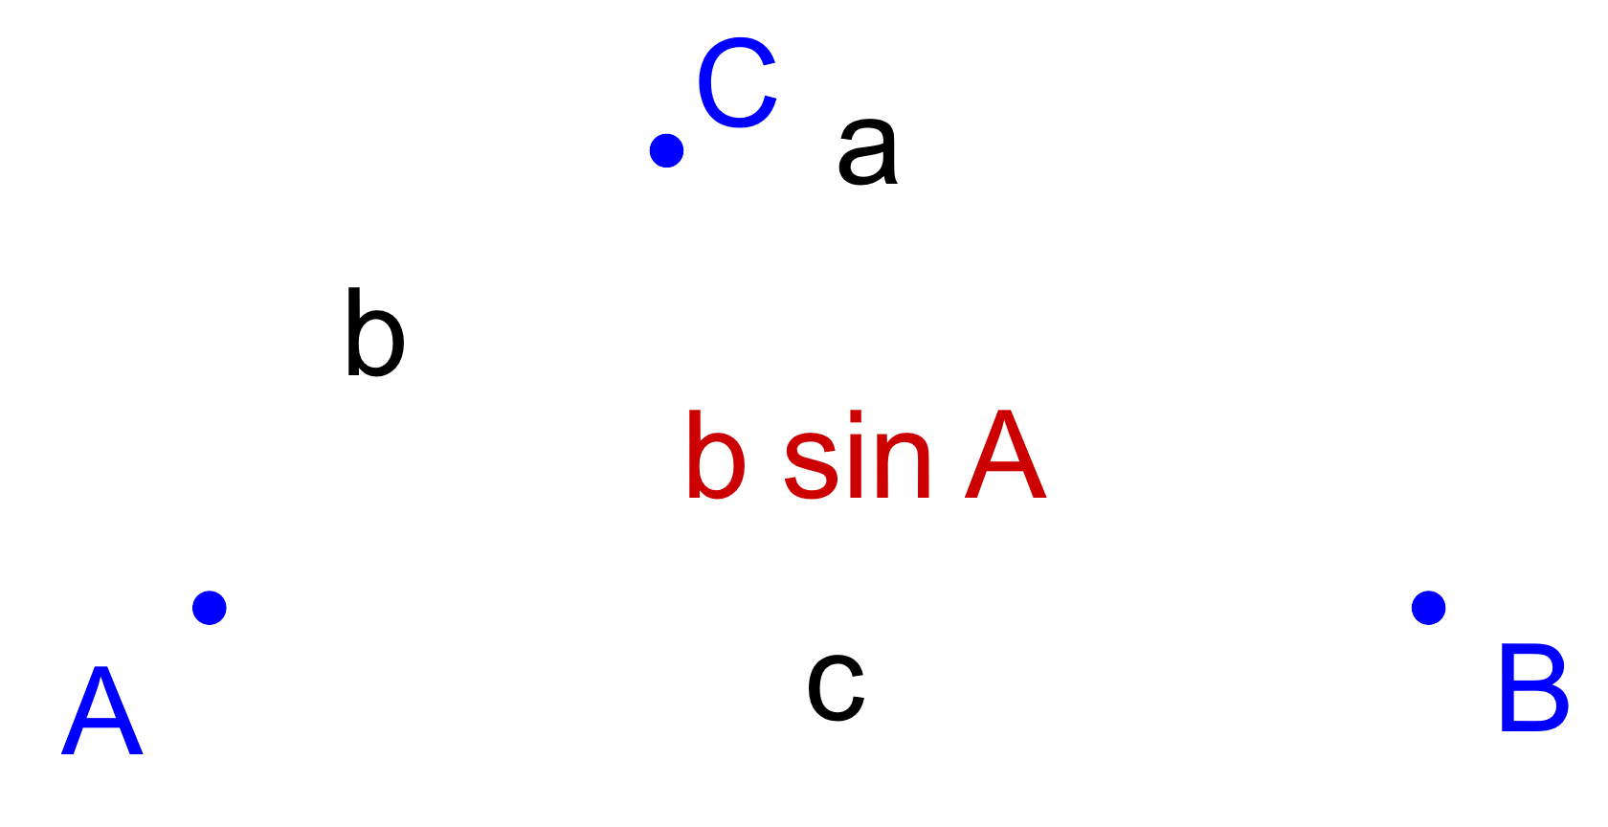
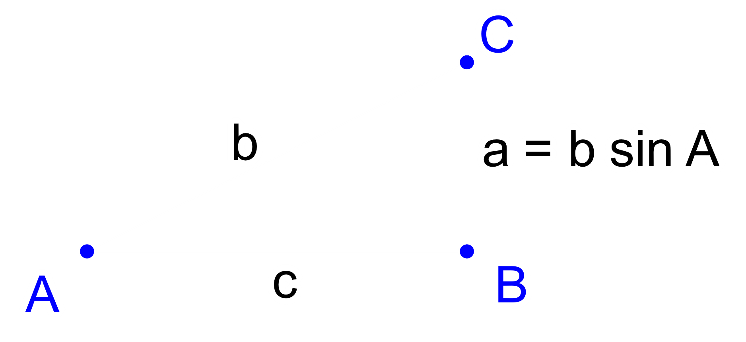
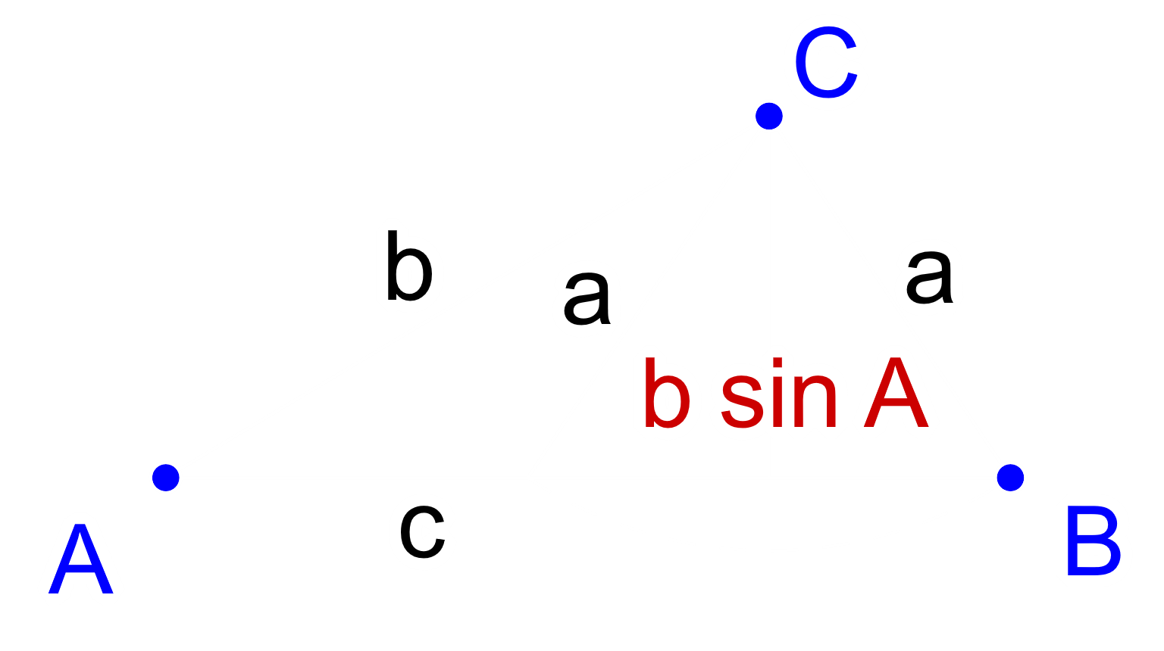
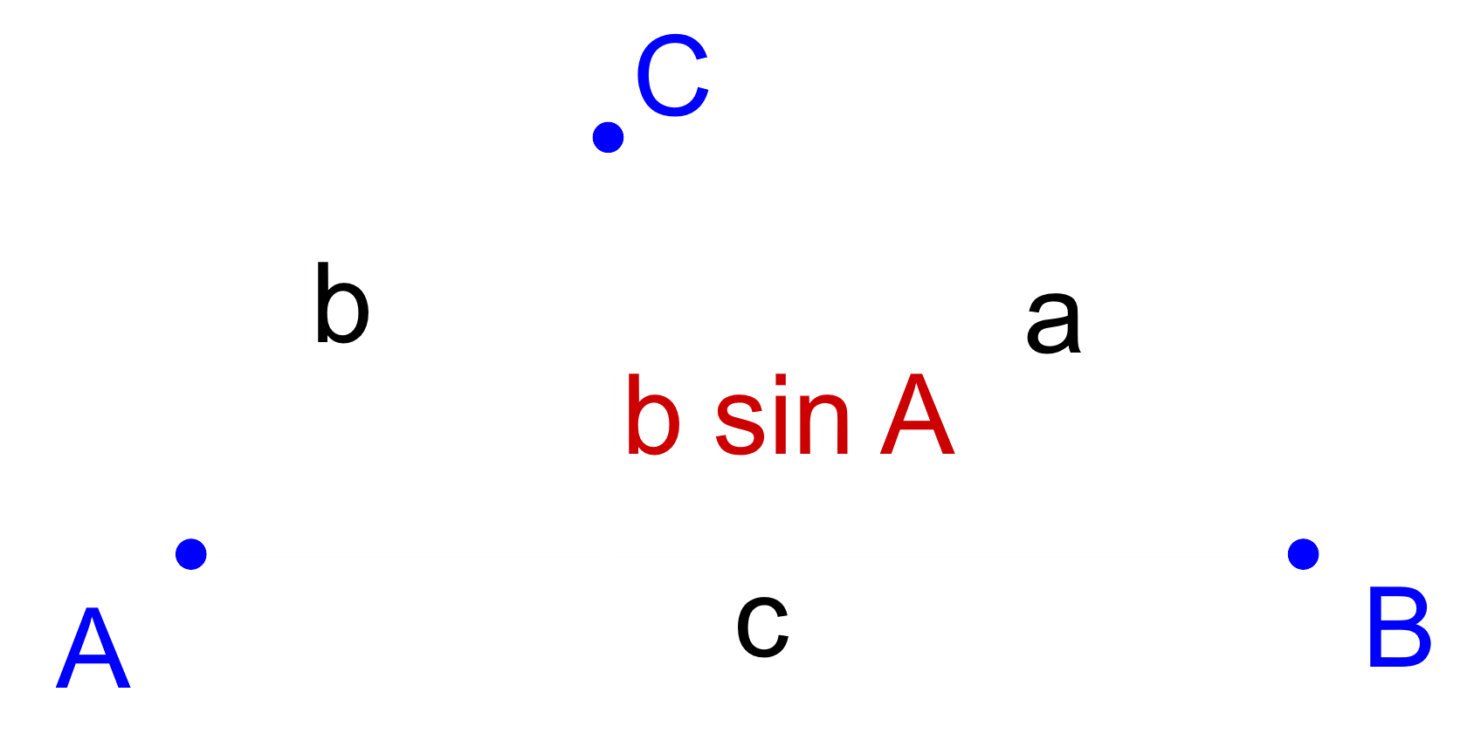
6-01 Law of Sines
If A < 90° and
a = b sin A, then 1 solution
a > b sin A and a ≥ b, 1 solution
a < b sin A, then 0 solutions
b sin A < a < b, then 2 solutions

Slide 8
6-01 Law of Sines
Solve ΔABC where A = 58°, a = 4.5, and b = 5
1st Solution
Notes:
SSA A<90°
$$b\sin{A}=5\sin{58°}≈4.2402$$
$$A<90°, a>b\sin{A} b>a$$
$$b\sin{A}<a<b$$
2 Solutions!
1st solution
$$\frac{\sin{A}}{a}=\frac{\sin{B}}{b}$$
$$\frac{\sin{58°}}{4.5}=\frac{\sin{B}}{5}$$
$$4.5\sin{B}=5\sin{58°}$$
$$\sin{B}≈0.9423$$
$$B≈\sin^{−1}{0.9423}≈70.44°$$
$$C=180°−58°−70.44°=51.56°$$
$$\frac{\sin{A}}{a}=\frac{\sin{C}}{c}$$
$$\frac{\sin{58°}}{4.5}=\frac{\sin{51.56°}}{c}$$
$$c\sin{58°}=4.5\sin{51.56°}$$
$$c=\frac{4.5\sin{51.56°}}{\sin{58°}}≈4.16$$
2nd solution
$$B^{′}=180°−B$$
$$B^{′}=180°−70.44°=109.56°$$
$$C^{′}=180°−A−B^{′}$$
$$C^{′}=180°−58°−109.56°=12.44°$$
$$\frac{\sin{A}}{a}=\frac{\sin{C^{′}}}{c^{′}}$$
$$\frac{\sin{58°}}{4.5}=\frac{\sin{12.44°}}{c^{′}}$$
$$c^{′}\sin{58°}=4.5\sin{12.44°}$$
$$c^{′}=1.14$$

Slide 9
6-01 Law of Sines
Solve ΔABC where A = 58°, a = 4.5, and b = 5
2nd Solution
Notes:
2nd solution
$$B^{′}=180°−B$$
$$B^{′}=180°−70.44°=109.56°$$
$$C^{′}=180°−A−B^{′}$$
$$C^{′}=180°−58°−109.56°=12.44°$$
$$\frac{\sin{A}}{a}=\frac{\sin{C^{′}}}{c^{′}}$$
$$\frac{\sin{58°}}{4.5}=\frac{\sin{12.44°}}{c^{′}}$$
$$c^{′}\sin{58°}=4.5\sin{12.44°}$$
$$c^{′}=1.14$$

Slide 10
6-01 Law of Sines
Area of a Triangle
$A=\frac{1}{2}bh$
$\sin{A}=\frac{h}{c}$
$c\sin{A}=h$
$Area=\frac{1}{2}bc\sin{A}$
$Area=\frac{1}{2}ac\sin{B}$
$Area=\frac{1}{2}ab\sin{C}$

Slide 11
6-02 Law of Cosines
In this section, you will:
Solve oblique triangles using the law of cosines.
Find the area of triangles using Heron’s formula.

Slide 12
6-02 Law of Cosines
When you can’t use Law of Sines
SAS, SSS
Law of Cosines
$a^{2}=b^{2}+c^{2}−2bc\cos{A}$
$b^{2}=a^{2}+c^{2}−2ac\cos{B}$
$c^{2}=a^{2}+b^{2}−2ab\cos{C}$
Notes:
You either solve for the first side or the angle. Never solve for a side in the middle.

Slide 13
6-02 Law of Cosines
Solve ΔABC where a = 20, b = 18, c = 13
Notes:
$$a^{2}=b^{2}+c^{2}−2bc\cos{A}$$
$${20}^{2}={18}^{2}+{13}^{2}−2\left(18\right)\left(13\right)\cos{A}$$
$$400=324+169−468\cos{A}$$
$$−93=−468\cos{A}$$
$$0.1987=\cos{A}$$
$$78.5°=A$$
$$b^{2}=a^{2}+c^{2}−2ac\cos{B}$$
$${18}^{2}={20}^{2}+{13}^{2}−2\left(20\right)\left(13\right)\cos{B}$$
$$324=400+169−520\cos{B}$$
$$−245=−520\cos{B}$$
$$0.4712=\cos{B}$$
$$61.9°=B$$
$$C=180°−A−B$$
$$C=180°−78.5°−61.9°=39.6°$$

Slide 14
6-02 Law of Cosines
Area of a Triangle given all Sides
Heron’s Formula
$Area=\sqrt{s\left(s−a\right)\left(s−b\right)\left(s−c\right)}$
Where $s=\frac{a+b+c}{2}$
Find the area of a triangle with sides 14 cm, 21 cm, 27 cm
Notes:
$$s=\frac{a+b+c}{2}$$
$$s=\frac{14+21+27}{2}=31$$
$$Area=\sqrt{s\left(s−a\right)\left(s−b\right)\left(s−c\right)}$$
$$Area=\sqrt{31\left(31−14\right)\left(31−21\right)\left(31−27\right)}≈145.19 cm^{2}$$

Slide 15
6-03 Vectors
In this section, you will:
Write vectors in component form.
Find the magnitude of vectors.
Add, subtract, and scalar multiply vectors.
Find a unit vector.

Slide 16
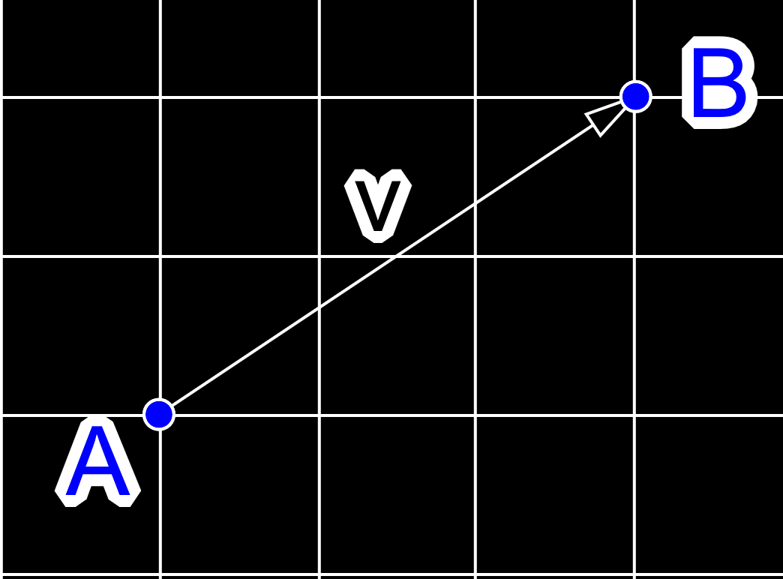
6-03 Vectors
Vector
Directed line segment $\overset{⃑}{v}$
Has direction and magnitude
Magnitude $\left\|\overset{⃑}{v}\right\|$ is length of the segment
Component form
$\overset{⃑}{v}=\left\langle v_{1},v_{2}\right\rangle$
Terminal – initial point
$\overset{⃑}{v}=\left\langle q_{1}−p_{1}, q_{2}−p_{2}\right\rangle =\left\langle v_{1},v_{2}\right\rangle$
$\left\|\overset{⃑}{v}\right\|=\sqrt{{\left(q_{1}−p_{1}\right)}^{2}+{\left(q_{2}−p_{2}\right)}^{2}}$ $=\sqrt{v_{1}^{2}+v_{2}^{2}}$

Slide 17
6-03 Vectors
Find the component form of the vector and its magnitude if its initial point is (1, 7) and its terminal point is (4, 3).
Notes:
$$\overset{⃑}{v}=\left\langle 4−1,3−7\right\rangle =\left\langle 3, −4\right\rangle$$
$$\left\|\overset{⃑}{v}\right\|=\sqrt{3^{2}+{\left(−4\right)}^{2}}=5$$

Slide 18
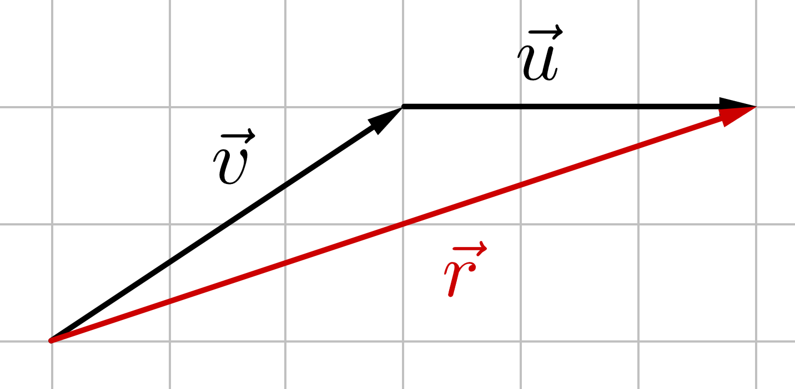
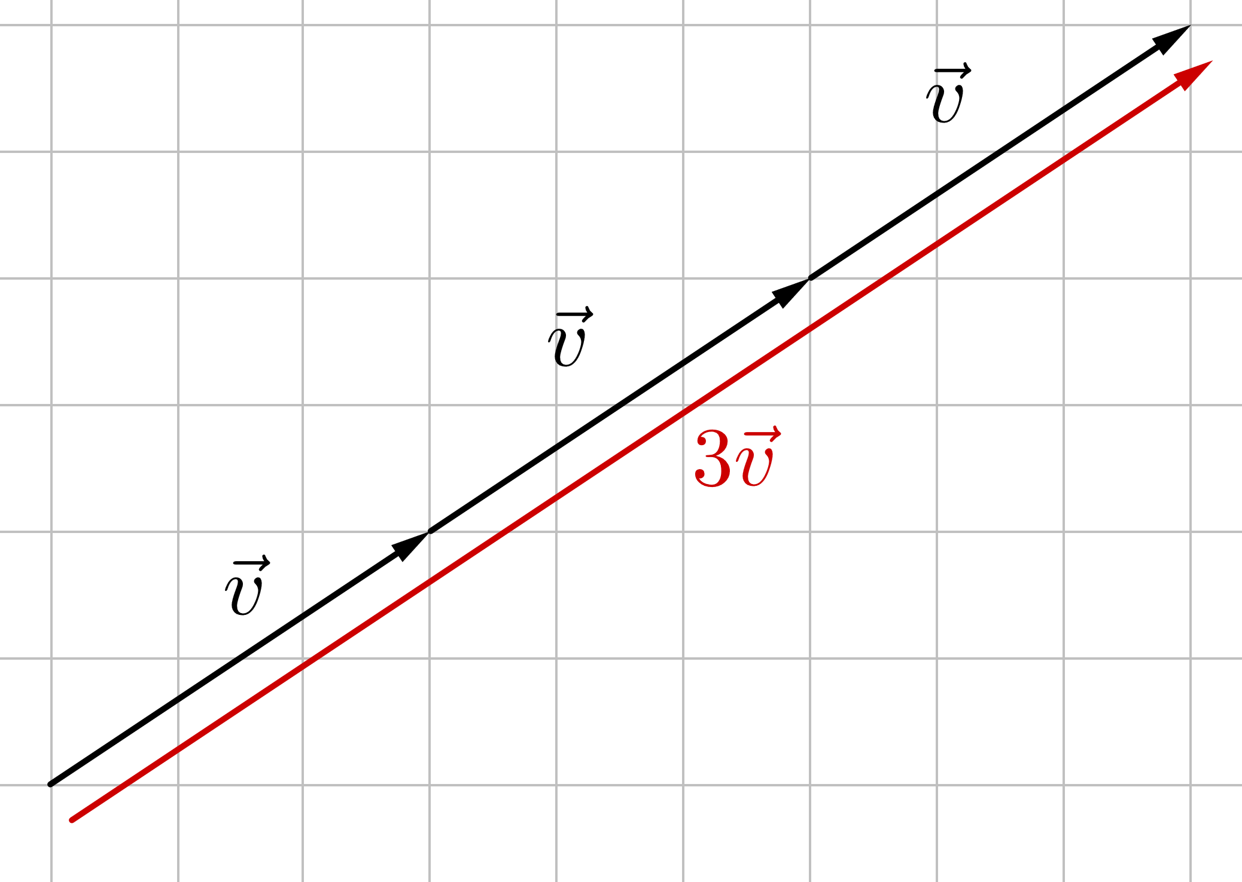
6-03 Vectors
Vector Operations
Scalar Multiplication
$k \overset{⃑}{v}=⟨kv_{1},kv_{2}⟩$
If k is negative it goes in opposite direction
Add
Add corresponding components
$\overset{⃑}{v}+\overset{⃑}{u}=⟨v_{1}+u_{1}, v_{2}+u_{2}⟩$

Slide 19
6-03 Vectors
$\left\langle 2, 3\right\rangle +⟨1, 0⟩$
Notes:
$$\left\langle 2,3\right\rangle +⟨1,0⟩$$
$$\left\langle 2+1, 3+0\right\rangle$$
$$⟨3, 3⟩$$

Slide 20
6-03 Vectors
Let $\overset{⃑}{u}=⟨1, 6⟩$ and $\overset{⃑}{v}=⟨−4, 2⟩$, find
$3\overset{⃑}{u}$
Notes:
Do graphically also
$$3\overset{⃑}{u}$$
$$\left\langle 3∙1, 3∙6\right\rangle$$
$$⟨3, 18〉$$

Slide 21
6-03 Vectors
Let $\overset{⃑}{u}=⟨1, 6⟩$ and $\overset{⃑}{v}=⟨−4, 2⟩$, find
$2\overset{⃑}{v}+\overset{⃑}{u}$
Notes:
Do graphically also
$$2\overset{⃑}{v}+\overset{⃑}{u}$$
$$\left\langle 2\left(−4\right), 2\left(2\right)\right\rangle +⟨1, 6〉$$
$$\left\langle −8, 4\right\rangle +\left\langle 1, 6\right\rangle$$
$$⟨−7, 10⟩$$

Slide 22
6-03 Vectors
Unit Vectors
Vector in the same direction, but magnitude is 1 unit
$\hat{u}=\frac{\overset{⃑}{v}}{\left\|\overset{⃑}{v}\right\|}$
Special Unit Vectors
$\hat{i}=\left\langle 1, 0\right\rangle$
$\hat{j}=\left\langle 0, 1\right\rangle$
Linear Combination Form
$3\hat{i}+2\hat{j}=\left\langle 3, 2\right\rangle$

Slide 23
6-03 Vectors
Let $\overset{⃑}{v}=3\hat{i}−4\hat{j}$ and $\overset{⃑}{w}=2\hat{i}+9\hat{j}$, find $2\overset{⃑}{v}+\overset{⃑}{w}$.
Notes:
$$2\left(3\hat{i}−4\hat{j}\right)+\left(2\hat{i}+9\hat{j}\right)$$
$$6\hat{i}−8\hat{j}+2\hat{i}+9\hat{j}$$
$$8\hat{i}+\hat{j}$$

Slide 24
6-04 Writing Vectors in Trigonometric Form
In this section, you will:
Write vectors in trigonometric form.
Find the components of a vector.
Solve real-life problems using vectors.

Slide 25
6-04 Writing Vectors in Trigonometric Form
Direction Angle
$v_{x}=\left\|\overset{⃑}{v}\right\|\cos{θ}$
$v_{y}=\left\|\overset{⃑}{v}\right\|\sin{θ}$
$\overset{⃑}{v}=\left\|\overset{⃑}{v}\right\|\left\langle \cos{θ},\sin{θ}\right\rangle$
$\tan{θ}=\frac{v_{y}}{v_{x}}$

Slide 26
6-04 Writing Vectors in Trigonometric Form
A force of 500 lbs is required to pull a boat up a ramp inclined at 12° from the horizontal. Find the weight of the boat.
Notes:
$$w_{1}=w\sin{12°}=500$$
$$w=2405 lbs$$

Slide 27
6-04 Writing Vectors in Trigonometric Form
Write the vector in trig form.
$⟨−12, 5⟩$
Write the vector in component form.
$10⟨\cos{120°},\sin{120°}⟩$
Notes:
$$\left\langle −12, 5\right\rangle$$
$$∥\vec{v}∥=\sqrt{{\left(−12\right)}^{2}+5^{2}}=13$$
$$\tan{θ}=\frac{5}{−12}→θ=−22.6°$$
This is in quadrant IV because that is want inverse tangent gives, but should be in quadrant II (graph the vector). Add 180° to get the correct angle.
$$θ=−22.6°+180°=157.4°$$
$$\vec{v}=∥\vec{v}∥\left\langle \cos{157.4°},\sin{157.4°}\right\rangle$$
$$10\left\langle \cos{120°},\sin{120°}\right\rangle$$
$$10\left\langle −\frac{1}{2},\frac{\sqrt{3}}{2}\right\rangle$$
$$\left\langle −5, 5\sqrt{3}\right\rangle$$

Slide 28
6-04 Writing Vectors in Trigonometric Form
Find the component form of the vector representing velocity of an airplane descending at 100 mph at 45° below the horizontal.
Notes:
$$\overset{⃑}{v}=\left\|\overset{⃑}{v}\right\|\left\langle \cos{θ},\sin{θ}\right\rangle$$
$$=100 mph \left\langle \cos{−45°},\sin{−45°}\right\rangle$$
$$=100 mph \left\langle \frac{\sqrt{2}}{2}, −\frac{\sqrt{2}}{2}\right\rangle$$
$$=\left\langle 50\sqrt{2}, −50\sqrt{2}\right\rangle mph$$

Slide 29
6-04 Writing Vectors in Trigonometric Form
Add the vectors. Write the result in trig form.
$4\left\langle \cos{210°},\sin{210°}\right\rangle +2\left\langle \cos{30°},\sin{30°}\right\rangle$
Notes:
Put in component form
$$4\left\langle −\frac{\sqrt{3}}{2}, −\frac{1}{2}\right\rangle +2\left\langle \frac{\sqrt{3}}{2},\frac{1}{2}\right\rangle$$
$$\left\langle −2\sqrt{3}, −2\right\rangle +\left\langle \sqrt{3}, 1\right\rangle$$
Add
$$\left\langle −\sqrt{3}, −1\right\rangle$$
Put in trig form. Find the magnitude
$$∥\vec{r}∥=\sqrt{{\left(−\sqrt{3}\right)}^{2}+{\left(−1\right)}^{2}}=2$$
Find angle
$$\tan{θ}=\frac{v_{y}}{v_{x}}$$
$$\tan{θ}=\frac{−1}{−\sqrt{3}}→θ=30°+180°=210°$$
Write result
$$2⟨\cos{210°},\sin{210°}⟩$$

Slide 30
6-04 Writing Vectors in Trigonometric Form
An airplane is traveling at 724 km/h at N 30° E. If the wind velocity is 32 km/h from the west, find the resultant speed and direction of the plane.
Notes:
$$\overset{⃑}{p}=724\left\langle \cos{60°},\sin{60°}\right\rangle =724\left\langle \frac{1}{2},\frac{\sqrt{3}}{2}\right\rangle =\left\langle 362, 362\sqrt{3}\right\rangle$$
$$\overset{⃑}{w}=\left\langle 32, 0\right\rangle$$
$$\overset{⃑}{p}+\overset{⃑}{w}=\left\langle 362, 362\sqrt{3}\right\rangle +\left\langle 32, 0\right\rangle =\left\langle 394, 362\sqrt{3}\right\rangle$$
Speed is magnitude
$$speed=\sqrt{{394}^{2}+{\left(362\sqrt{3}\right)}^{2}}≈740.5 km/h$$
$$\tan{θ}=\frac{v_{2}}{v_{1}}$$
$$\tan{θ}=\frac{362\sqrt{3}}{394}$$
$$θ=E 57.9° N$$

Slide 31
6-05 Dot Products
In this section, you will:
Evaluate dot products of two vectors.
Find the angle between two vectors.
Find orthogonal components of a vector.

Slide 32
6-05 Dot Products
Dot Product
$\overset{⃑}{u}=⟨u_{1}, u_{2}⟩$, $\overset{⃑}{v}=\left\langle v_{1},v_{2}\right\rangle$
$\overset{⃑}{u}•\overset{⃑}{v}=u_{1}v_{1}+u_{2}v_{2}$
Find $\left\langle 5, −4\right\rangle •⟨9, −2⟩$
Notes:
$$5\left(9\right)+\left(−4\right)\left(−2\right)$$
$$45+8$$
$$53$$

Slide 33
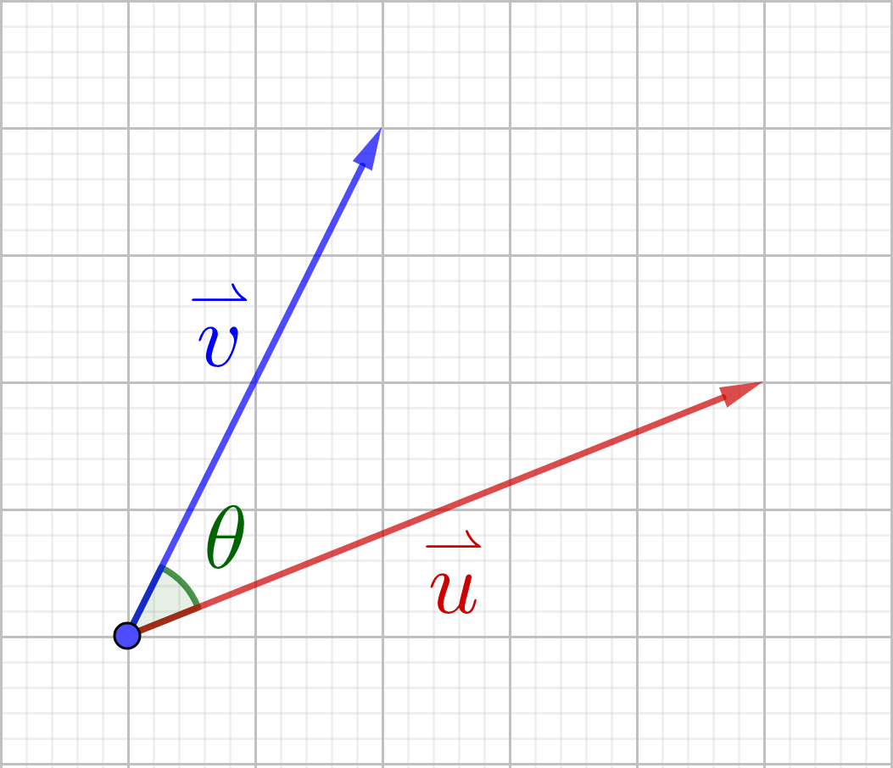
6-05 Dot Products
Angle between vectors
$\overset{⃑}{u}•\overset{⃑}{v}=\left\|\overset{⃑}{u}\right\|\left\|\overset{⃑}{v}\right\|\cos{θ}$
Find the angle between $\left\langle 5, −4\right\rangle$ and $⟨9, −2⟩$
Notes:
$$\overset{⃑}{u}•\overset{⃑}{v}=\left\|\overset{⃑}{u}\right\|\left\|\overset{⃑}{v}\right\|\cos{θ}$$
$$\left\langle 5, −4\right\rangle •\left\langle 9, −2\right\rangle =\sqrt{5^{2}+{\left(−4\right)}^{2}}\sqrt{9^{2}+{\left(−2\right)}^{2}}\cos{θ}$$
$$45+8=\sqrt{41}\sqrt{85}\cos{θ}$$
$$53=\sqrt{3485}\cos{θ}$$
$$0.8978=\cos{θ}$$
$$26.13°=θ$$

Slide 34
6-05 Dot Products
If $\overset{⃑}{u}•\overset{⃑}{v}=0$, then $\overset{⃑}{u}$ and $\overset{⃑}{v}$ are orthogonal (perpendicular)
If $\overset{⃑}{u}=k\overset{⃑}{v}$, then $\overset{⃑}{u}$ and $\overset{⃑}{v}$ are parallel (or antiparallel)
Are $\left\langle 1, −4\right\rangle$ and $\left\langle 6, 2\right\rangle$ orthogonal, parallel, or neither?
Notes:
Check for ⊥
$$\left\langle 1, −4\right\rangle •\left\langle 6, 2\right\rangle$$
$$1\left(6\right)•\left(−4\right)\left(2\right)$$
$$6+\left(−8\right)$$
$$−2$$
Not ⊥
Check for ||
Using the x-components, k = 6
Using the y-components, k = -1/2
Not ||

Slide 35
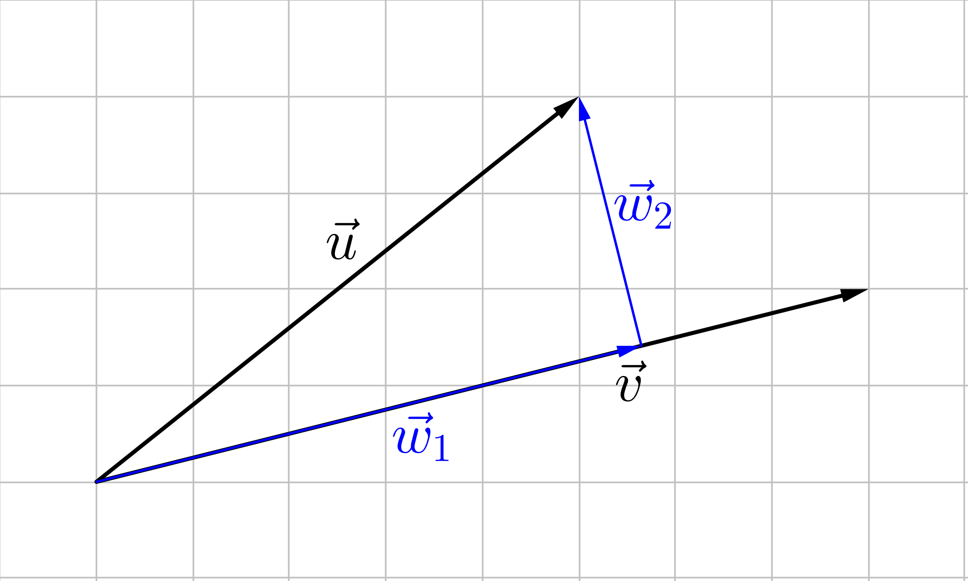
6-05 Dot Products
Find Vector Components
Let $\overset{⃑}{u}$ and $\overset{⃑}{v}$ be vectors such that $\overset{⃑}{u}=\overset{⃑}{w_{1}}+\overset{⃑}{w_{2}}$ where $\overset{⃑}{w_{1}}$ and $\overset{⃑}{w_{2}}$ are orthogonal and $\overset{⃑}{w_{1}}$ is parallel to $\overset{⃑}{v}$. $\overset{⃑}{w_{1}}$ and $\overset{⃑}{w_{2}}$ are components of $\overset{⃑}{u}$.
$\overset{⃑}{w_{1}}$ is the projection of $\overset{⃑}{u}$ onto $\overset{⃑}{v}$: $\overset{⃑}{w_{1}}=proj_{\overset{⃑}{v}}\overset{⃑}{u}$
$\overset{⃑}{w_{1}}=proj_{\overset{⃑}{v}}\overset{⃑}{u}=\frac{\overset{⃑}{u}•\overset{⃑}{v}}{{\left\|\overset{⃑}{v}\right\|}^{2}}\overset{⃑}{v}$
$\overset{⃑}{w_{2}}=\overset{⃑}{u}−\overset{⃑}{w_{1}}$
$Work=\overset{⃑}{F}•\overset{⃑}{d}$
Notes:
$$proj_{\overset{⃑}{v}}\overset{⃑}{u}=\frac{\overset{⃑}{u}•\overset{⃑}{v}}{{\left\|\overset{⃑}{v}\right\|}^{2}}\overset{⃑}{v}$$
$$\frac{\left\|\overset{⃑}{u}\right\|\left\|\overset{⃑}{v}\right\|\cos{θ}}{\left\|\overset{⃑}{v}\right\|}∙\frac{\overset{⃑}{v}}{\left\|\overset{⃑}{v}\right\|}$$
$$\left\|\overset{⃑}{w}\right\|∙unit vector in direction of \overset{⃑}{v}$$

Slide 36
6-05 Dot Products
Find the projection of $\overset{⃑}{u}=\left\langle 3, 4\right\rangle$ onto $\overset{⃑}{v}=\left\langle 8, 2\right\rangle$. Then write $\overset{⃑}{u}$ as the sum of 2 orthogonal vectors.
Notes:
$$\overset{⃑}{w_{1}}=proj_{\overset{⃑}{v}}\overset{⃑}{u}=\frac{\overset{⃑}{u}•\overset{⃑}{v}}{{\left\|\overset{⃑}{v}\right\|}^{2}}\overset{⃑}{v}$$
$$\overset{⃑}{w_{1}}=\frac{\left\langle 3, 4\right\rangle •\left\langle 8, 2\right\rangle }{{\sqrt{8^{2}+2^{2}}}^{2}}\left\langle 8, 2\right\rangle$$
$$\overset{⃑}{w_{1}}=\frac{24+8}{64+4}\left\langle 8, 2\right\rangle$$
$$\overset{⃑}{w_{1}}=\frac{32}{68}\left\langle 8, 2\right\rangle =\frac{8}{17}\left\langle 8, 2\right\rangle =\left\langle \frac{64}{17},\frac{16}{17}\right\rangle$$
$$\overset{⃑}{u}=\overset{⃑}{w_{1}}+\overset{⃑}{w_{2}}$$
$$\overset{⃑}{w_{2}}=\overset{⃑}{u}−\overset{⃑}{w_{1}}$$
$$\overset{⃑}{w_{2}}=\left\langle 3, 4\right\rangle −\left\langle \frac{64}{17},\frac{16}{17}\right\rangle$$
$$\overset{⃑}{w_{2}}=\left\langle \frac{51}{17},\frac{68}{17}\right\rangle −\left\langle \frac{64}{17},\frac{16}{17}\right\rangle$$
$$\overset{⃑}{w_{2}}=\left\langle −\frac{13}{17},\frac{52}{17}\right\rangle$$
$$\overset{⃑}{u}=\left\langle \frac{64}{17},\frac{16}{17}\right\rangle +\left\langle −\frac{13}{17},\frac{52}{17}\right\rangle$$

Slide 37
6-06 Trigonometric Form of a Complex Number
In this section, you will:
Graph complex numbers.
Find the absolute value of complex numbers.
Write complex numbers in trigonometric form.

Slide 38
6-06 Trigonometric Form of a Complex Number
Graph Complex Number
$a+bi$
Graph by moving horizontally a, and vertically b
x-axis is real
y-axis is imaginary
Graph
$2+3i$
$−3−4i$

Slide 39
6-06 Trigonometric Form of a Complex Number
Complex number
Absolute value is distance from origin
$\left|a+bi\right|=\sqrt{a^{2}+b^{2}}$
$\left|4+i\right|$
Notes:
$$\left|4+i\right|=\sqrt{4^{2}+1^{2}}=\sqrt{17}$$

Slide 40
6-06 Trigonometric Form of a Complex Number
$a=r\cos{θ}$
$b=r\sin{θ}$
$r=\sqrt{a^{2}+b^{2}}$
$\tan{θ}=\frac{b}{a}$
$z=a+bi$
$z=r\cos{θ}+r\sin{θ} i$
$z=r\left(\cos{θ}+i\sin{θ}\right)$
r is modulus, θ is argument
Notes:
$$\left|4+i\right|=\sqrt{4^{2}+1^{2}}=\sqrt{17}$$

Slide 41
6-06 Trigonometric Form of a Complex Number
Write in standard form
$z=8\left(\cos{\frac{2π}{3}}+i\sin{\frac{2π}{3}}\right)$
Write in trig form
$z=−2−2i$
Notes:
$$z=8\left(−\frac{1}{2}+i\frac{\sqrt{3}}{2}\right)$$
$$z=−4+4\sqrt{3}i$$
$$r=\sqrt{{\left(−2\right)}^{2}+{\left(−2\right)}^{2}}=\sqrt{8}=2\sqrt{2}$$
$$\tan{θ}=\frac{−2}{−2}=1$$
$$θ=\frac{5π}{4}$$
$$z=2\sqrt{2}\left(\cos{\frac{5π}{4}}+i\sin{\frac{5π}{4}}\right)$$

Slide 42
6-07 Trigonometric Form of a Complex Number Operations
In this section, you will:
Multiply and divide complex numbers in trigonometric form.
Use exponents with complex numbers in trigonometric form.
Find all the roots of complex numbers.

Slide 43
6-07 Trigonometric Form of a Complex Number Operations
Multiplication and Division
$\left(2+i\right)\left(3−2i\right)$
Easier way
$z_{1}=r_{1}\left(\cos{θ}+i\sin{θ}\right)$
$z_{2}=r_{2}\left(\cos{θ}+i\sin{θ}\right)$
$z_{1}z_{2}=r_{1}r_{2}(\cos\left(θ_{1}+θ_{2}\right)+i\sin\left(θ_{1}+θ_{2}\right))$
Notes:
$$\left(2+i\right)\left(3−2i\right)$$
$$6−4i+3i−2i^{2}$$
$$6−4i+3i−2\left(−1\right)$$
$$8−i$$

Slide 44
6-07 Trigonometric Form of a Complex Number Operations
$\frac{2+i}{3−2i}$
Easier way
$\frac{z_{1}}{z_{2}}=\frac{r_{1}}{r_{2}}\left(\cos\left(θ_{1}−θ_{2}\right)+i\sin\left(θ_{1}−θ_{2}\right)\right)$
Notes:
$$\frac{2+i}{3−2i}$$
$$\frac{\left(2+i\right)}{\left(3−2i\right)}∙\frac{\left(3+2i\right)}{\left(3+2i\right)}$$
$$\frac{6+4i+3i+2i^{2}}{9+6i−6i−4i^{2}}$$
$$\frac{6+4i+3i+2(−1)}{9+6i−6i−4(−1)}$$
$$\frac{4+7i}{13}$$
$$\frac{4}{13}+\frac{7}{13}i$$

Slide 45
6-07 Trigonometric Form of a Complex Number Operations
$z_{1}=3\left(\cos{\frac{π}{2}}+i\sin{\frac{π}{2}}\right)$
$z_{2}=6\left(\cos{\frac{π}{4}}+i\sin{\frac{π}{4}}\right)$
$z_{1}z_{2}$
$\frac{z_{1}}{z_{2}}$
Notes:
$$z_{1}z_{2}=3∙6\left(\cos\left(\frac{π}{2}+\frac{π}{4}\right)+i\sin\left(\frac{π}{2}+\frac{π}{4}\right)\right)$$
$$18\left(\cos{\frac{3π}{4}}+i\sin{\frac{3π}{4}}\right)$$
$$\frac{z_{1}}{z_{2}}=\frac{3}{6}\left(\cos\left(\frac{π}{2}−\frac{π}{4}\right)+i\sin\left(\frac{π}{2}−\frac{π}{4}\right)\right)$$
$$\frac{1}{2}\left(\cos{\frac{π}{4}}+i\sin{\frac{π}{4}}\right)$$

Slide 46
6-07 Trigonometric Form of a Complex Number Operations
Exponents
DeMoivre’s Theorem
$z^{n}=r^{n}\left(\cos\left(nθ\right)+i\sin\left(nθ\right)\right)$
Let $z=1+i$, find $z^{4}$
Notes:
Put z in trig form
$$r=\sqrt{1^{2}+1^{2}}=\sqrt{2}$$
$$\tan{θ}=\frac{1}{1}=1→θ=\frac{π}{4}$$
$$z=\sqrt{2}\left(\cos{\frac{π}{4}}+i\sin{\frac{π}{4}}\right)$$
$$z^{4}={\sqrt{2}}^{4}\left(\cos\left(4\left(\frac{π}{4}\right)\right)+i\sin\left(4\left(\frac{π}{4}\right)\right)\right)$$
$$z^{4}=4\left(\cos{π}+i\sin{π}\right)$$
$$z^{4}=−4$$

Slide 47
6-07 Trigonometric Form of a Complex Number Operations
Solve by factoring
$x^{4}−16=0$
Roots of Complex Numbers
$\sqrt[n]{z}=\sqrt[n]{r}\left(\cos\left(\frac{θ}{n}+\frac{2πk}{n}\right)+i\sin\left(\frac{θ}{n}+\frac{2πk}{n}\right)\right)$
Where k = 0, 1, 2, …, n − 1
These are spaced out evenly around a circle with radius $\sqrt[n]{r}$
Notes:
$$\left(x^{2}−4\right)\left(x^{2}+4\right)=0$$
$$\left(x−2\right)\left(x+2\right)\left(x^{2}+4\right)=0$$
$$x=2,−2, 2i, −2i$$

Slide 48
6-07 Trigonometric Form of a Complex Number Operations
Find the cube roots of $−6+6i$
Notes:
Put in trig form
$$r=\sqrt{{\left(−6\right)}^{2}+6^{2}}=6\sqrt{2}$$
$$\tan{θ}=\frac{6}{−6}=−1→θ=\frac{3π}{4}$$
$$z=6\sqrt{2}\left(\cos{\frac{3π}{4}}+i\sin{\frac{3π}{4}}\right)$$
$$\sqrt[n]{r}\left(\cos\left(\frac{θ}{n}+\frac{2πk}{n}\right)+i\sin\left(\frac{θ}{n}+\frac{2πk}{n}\right)\right)$$
$$\sqrt[3]{6\sqrt{2}}\left(\cos\left(\frac{\frac{3π}{4}}{3}+\frac{2πk}{3}\right)+i\sin\left(\frac{\frac{3π}{4}}{3}+\frac{2πk}{3}\right)\right)$$
$$\sqrt[3]{6\sqrt{2}}\left(\cos\left(\frac{3π}{12}+\frac{8πk}{12}\right)+i\sin\left(\frac{3π}{12}+\frac{8πk}{12}\right)\right)$$
K=0
$$\sqrt[3]{6\sqrt{2}}\left(\cos\left(\frac{3π}{12}+\frac{8π0}{12}\right)+i\sin\left(\frac{3π}{12}+\frac{8π0}{3}\right)\right)$$
$$\sqrt[3]{6\sqrt{2}}\left(\cos{\frac{π}{4}}+i\sin{\frac{π}{4}}\right)$$
$$1.4422+1.4422 i$$
K=1
$$\sqrt[3]{6\sqrt{2}}\left(\cos\left(\frac{3π}{12}+\frac{8π1}{12}\right)+i\sin\left(\frac{3π}{12}+\frac{8π1}{12}\right)\right)$$
$$\sqrt[3]{6\sqrt{2}}\left(\cos{\frac{11π}{12}}+i\sin{\frac{11π}{12}}\right)$$
$$−1.9701+0.5279 i$$
K=2
$$\sqrt[3]{6\sqrt{2}}\left(\cos\left(\frac{3π}{12}+\frac{8π2}{12}\right)+i\sin\left(\frac{3π}{12}+\frac{8π2}{12}\right)\right)$$
$$\sqrt[3]{6\sqrt{2}}\left(\cos{\frac{19π}{12}}+i\sin{\frac{19π}{12}}\right)$$
$$0.5279−1.9701 i$$

